Slide 1
E-commerce Customer & Sales Analytics
bigquery-public-data.thelook_ecommerce

Slide 2
Business objective
Identify the main drivers of revenue and potential opportunities for customer retention by:
analyzing customer behavior;
building an RFM segmentation of customers;
creating a dashboard

Slide 3
Key findings
Customers by country
  71% comes from 3 countries (China, USA and Brasil)
  Smaller markets in Australia, Asia, South America and Europe
  Chances to expand in smaller markets by making special discounts for clients coming from those countries
Profit by category
  Outerwear & Coats and Jeans stand out, then Jumpsuits & Rompers and Clothing Sets are by far the last categories
Orders over time
  Orders increasing (MoM)
Orders per customers by country
  1,25 orders per customer constant over countries

Slide 4
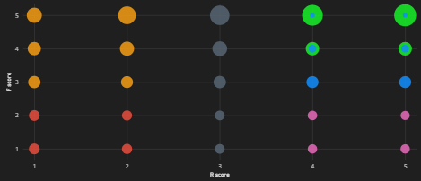
RFM segmentation
Customers segmented by:
R (recency) = days since last purchase
F (frequency) = number of orders
M (monetary) = revenue
Segments:
Champions (also M >= 4)
Loyal Customers
New Customers
At risk
Lost customers
Other
Note: not all customers could be segmented (i.e. no purchases, data quality issues, only «Cancelled» or «Returned» orders)

Slide 5
Key findings (RFM)
Customers distribution
  Most users have no orders (20k)
  Many users have only «cancelled» or «returned» orders (14k)
  A lot of «at risk» customers (14k) and «lost» customers (12k) -> dedicated discounts in order not encourage further purchase
Profit/margin
  Little differences in revenue and profit per customer
Revenue by country
  Little normalized differences
Revenue by gender
  Little normalized differences

Slide 6
Key findings (RFM)
Revenue by age bracket
  Little normalized differences
Revenue by gender
  Little normalized differences
Average time interval between purchases
  Little differences, on average is a little over 1 year
Customers with no orders over time
  Almost constant 20%

